Slide 1
Hypersensitivity

Slide 2
An immune reaction mobilizes various effector molecules to remove the antigens
These effector molecules induce a localized inflammatory response that eliminates antigen without extensively damaging the host’s tissue
However, this inflammatory response can have deleterious effects, resulting in significant tissue damage, This inappropriate immune response is termed hypersensitivity or allergy.

Slide 3
Portier and Richet coined the term anaphylaxis, loosely translated from Greek to mean the opposite of prophylaxis, to describe this overreaction.

Slide 4
Classification of Hypersensitivity
P. G. H. Gell and R. R. A. Coombs proposed a classification scheme in which hypersensitive reactions are divided into four types.
Three types of hypersensitivity occur within the humoral branch and are mediated by antibody or antigen-antibody complexes: IgE-mediated (type I), antibody-mediated (type II), and immune complex–mediated (type III).
A fourth type of hypersensitivity depends on reactions within the cell-mediated branch, and is termed delayed-type hypersensitivity, or DTH (type IV).

Slide 5
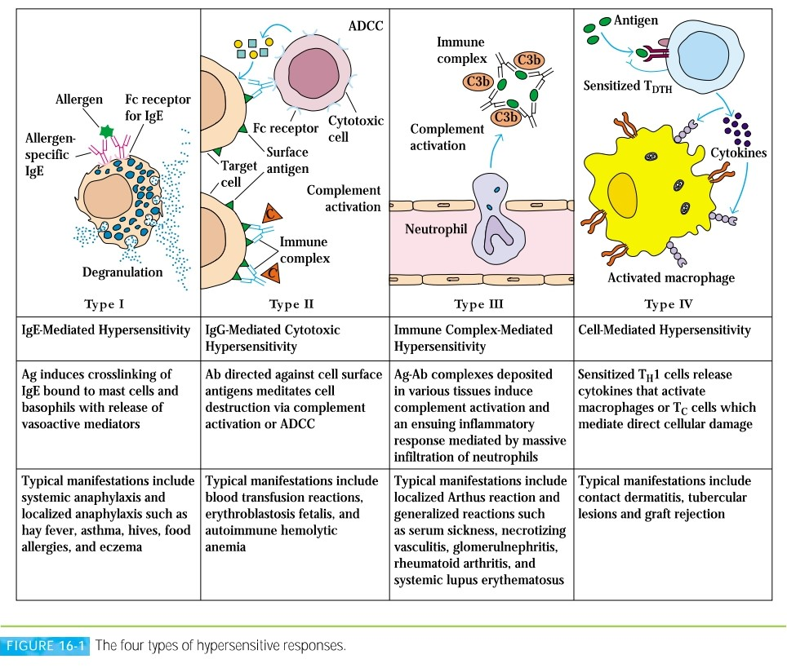

Slide 6
IgE-Mediated (Type I) Hypersensitivity
A type I hypersensitive reaction is induced by certain types of antigens referred to as allergens.
An allergen induces a humoral antibody response resulting in the generation of antibody-secreting plasma cells and memory cells.
The plasma cells secrete IgE.
This class of antibody binds with high affinity to Fc receptors on the surface of tissue mast cells and blood basophils. Mast cells and basophils coated by IgE are said to be sensitized.

Slide 7
A later exposure to the same allergen cross-links the membrane-bound IgE on sensitized mast cells and basophils, causing degranulation of these cells.
The pharmacologically active mediators released from the granules act on the surrounding tissues.
The principal effects—vasodilation and smooth-muscle contraction—may be either systemic or localized, depending on the extent of mediator release.

Slide 8
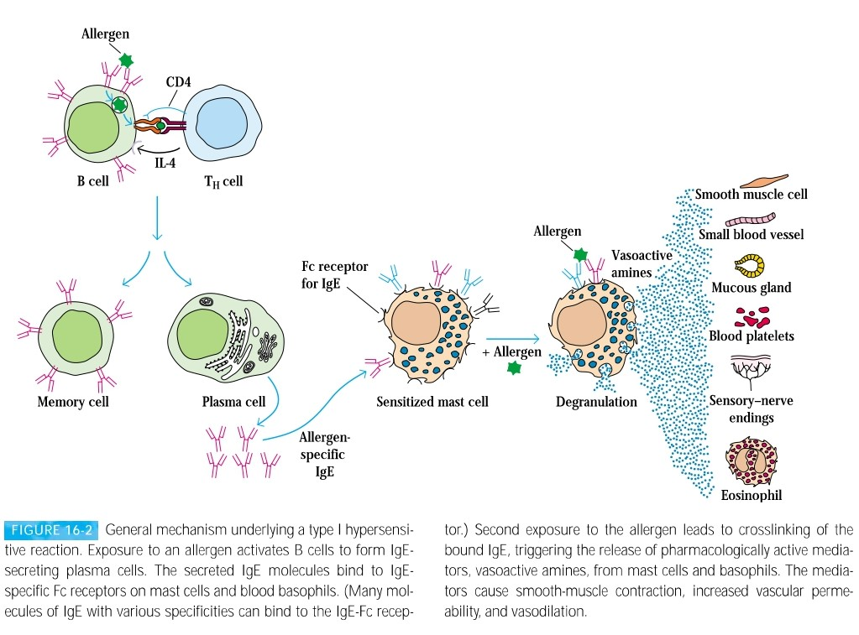

Slide 9
Components of Type-I Reaction
Allergen: The term allergen refers specifically to nonparasitic antigens capable of stimulating type I hypersensitive responses.
Some common allergens include Pollen grains, Some drugs like Penicillin, Local anesthetics, insect products, dust mites.

Slide 10
REAGINIC ANTIBODY (IGE):A human serum factor that reacts with allergens was first demonstrated by K. Prausnitz and H. Kustner in 1921. The nature of these P-K antibodies, or reagins, was experimentally demonstrated by K. and T. Ishizaka in the mid1960s, who gave the name to new isotype IgE.
IgE has two heavy ε and two light chains with a combined molecular weight of 190,000.
IgE bound to its receptor on mast cells and basophils, it is stable in that state for a number of weeks.

Slide 11
MAST CELLS AND BASOPHILS:
Basophils are granulocytes that stain with basic dyes containing electron-dense membrane-bound granules that contain pharmacologically active mediators.
Mast cells are present in the connective tissue, mucous membranes. Mast cells contain membrane bound granules and also secrete cytokines.

Slide 12
IgE-BINDING Fc RECEPTORS:The reaginic activity of IgE depends on its ability to bind to a receptor specific for the Fc region of the ε heavy chain. Two classes of FcεR been identified, designated FcεRI and FcεRII, which are expressed by different cell types.
Mast cells and basophils express FcεRI, which binds IgE with a high affinity
Atopic individuals have higher levels of FcεRII (CD23) on their lymphocytes and macrophages and higher levels of sCD23 in their serum than do nonatopic individuals.

Slide 13
The biochemical events that mediate degranulation of mast cells and blood basophils have many features in common.
IgE-mediated degranulation begins when an allergen crosslinks IgE that is bound (fixed) to the Fc receptor on the surface of a mast cell or basophil.
Receptor cross linkage leads to increase of calcium.
This leads to formation of prostaglandins and leukotrienes.
Increase in Calcium and cAMP helps in degranulation and release of chemicals.

Slide 14
Histamines, Cytokines, Serotonin leads to Increased vascular permeability; smooth-muscle contraction.
Eosinophil chemotactic factor (ECF-A) leads to Eosinophil chemotaxis.
Neutrophil chemotactic factor (NCF-A) leads to Neutrophil chemotaxis.

Slide 15
Localized Anaphylaxis (Atopy) include allergic rhinitis (hay fever), asthma, atopic dermatitis (eczema), and food allergies.

Slide 16
Antibody-Mediated Cytotoxic (Type II) Hypersensitivity
Type II hypersensitive reactions involve antibody-mediated destruction of cells.
Antibody can activate the complement system, creating pores in the membrane of a foreign cell or it can mediate cell destruction by antibodydependent cell-mediated cytotoxicity (ADCC).
In this process, cytotoxic cells with Fc receptors bind to the Fc region of antibodies on target cells and promote killing of the cells.
Antibody bound to a foreign cell also can serve as an opsonin, enabling phagocytic cells with Fc or C3b receptors to bind and phagocytose the antibody-coated cell

Slide 17
Immune Complex–Mediated (Type III) Hypersensitivity
The reaction of antibody with antigen generates immune complexes.
Generally this complexing of antigen with antibody facilitates the clearance of antigen by phagocytic cells.
In some cases, however, large amounts of immune complexes can lead to tissue-damaging type III hypersensitive reactions.

Slide 18
Type III hypersensitive reactions develop when immune complexes activate the complement system’s array of immune effector molecules.
Much of the tissue damage in type III reactions stems from release of lytic enzymes by neutrophils as they attempt to phagocytose immune complexes.
In addition, the activation of complement can induce aggregation of platelets, and the resulting release of clotting factors can lead to formation of microthrombi.

Slide 19
Type IV or Delayed-Type Hypersensitivity (DTH)
When some subpopulations of activated TH cells encounter certain types of antigens, they secrete cytokines that induce a localized inflammatory reaction called delayed-type hypersensitivity (DTH). The reaction is characterized by large influxes of nonspecific inflammatory cells, in particular, macrophages.

Slide 20
The development of the DTH response begins with an initial sensitization phase of 1–2 weeks after primary contact with an antigen. During this period, TH cells are activated and clonally expanded by antigen presented together with the requisite class II MHC molecule on an appropriate antigen presenting cells.

Slide 21
Subsequent exposure to the antigen induces the effector phase of the DTH response. In the effector phase, TH1 cells secrete a variety of cytokines that recruit and activate macrophages and other nonspecific inflammatory cells.
Once a DTH response begins, a complex interplay of nonspecific cells and mediators is set in motion that can result in tremendous amplification.
The heightened phagocytic activity and the buildup of lytic enzymes from macrophages in the area of infection lead to nonspecific destruction of cells.

